Slide 1
Predicting Daily Household Energy Consumption Using Kernel Methods and Gaussian Process
Name: Animesh Kashid
Hrishikesh Nikam
Viren Parmar
Prof: Deniz Erdogmus

Slide 2
01
02
03
04
Contents
05
06
07
08
09
Introduction
Dataset and Processing
Feature Engineering
Kernel Ridge Regression
Gaussian Process Regression
Experimental Setup
Results
Discussion
Conclusion
EECE 5644
Intro to Machine Learning

Slide 3
Importance: Forecasting household energy consumption is crucial for:
Demand planning
Grid stability
Energy-efficient resource allocation
Challenge: Linear models fail to capture nonlinear and seasonal patterns in energy data.
INTRODUCTION
EECE 5644
Intro to Machine Learning

Slide 4
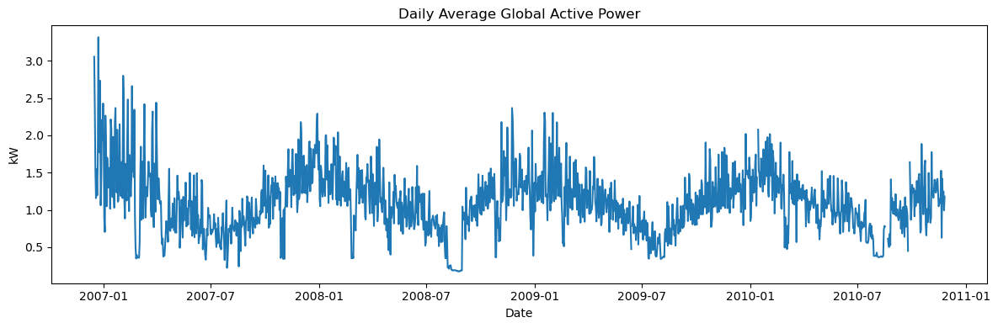
Dataset & Processing
UCI Household Electric Power Consumption Dataset
Minute-level data: Dec 2006 – Nov 2010
Variables: Active/Reactive power, voltage, intensity, sub-metering
Preprocessing:
Handle missing values (forward/backward fill)
Resample to daily averages
Standardize features (zero mean, unit variance)
EECE 5644
Intro to Machine Learning

Slide 5
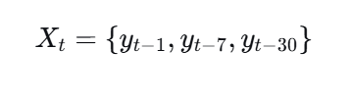
EECE 5644
Intro to Machine Learning
Univariate Model
Multivariate Model

Slide 6
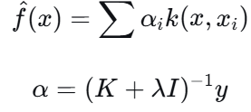
EECE 5644
Intro to Machine Learning
Kernel Ridge Regression (KRR)
Combines ridge regression with kernel trick in RKHS
Solution form:
Kernels used: RBF, Polynomial
Gaussian Process Regression (GPR)
Bayesian non-parametric model
Defined by mean and covariance kernel
Kernels used: RBF, Periodic, RBF+Periodic, Matern

Slide 7
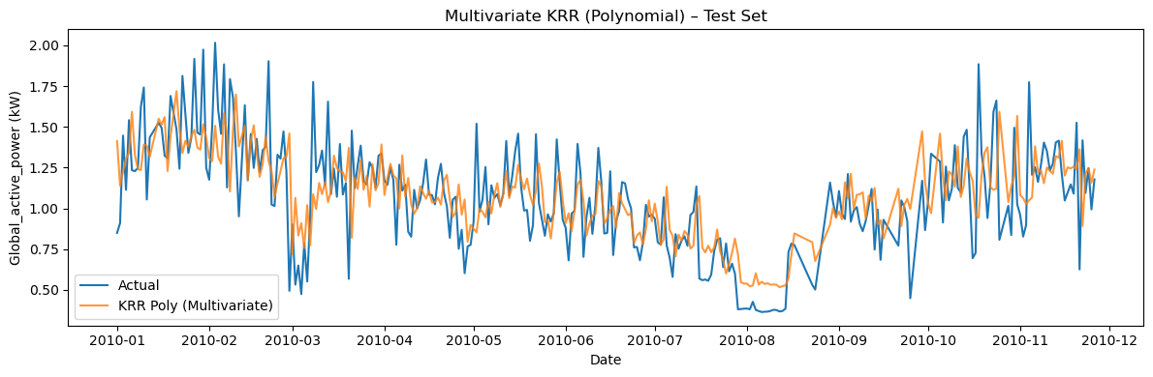
EECE 5644
Intro to Machine Learning
Experimental Setup
Baselines: Naïve (y_{t-1}), MA(7)
Models: Univariate vs. Multivariate KRR & GPR
Evaluation: RMSE, MAE
Validation: TimeSeriesSplit (5 folds)
Test period: 2010 data

Slide 8
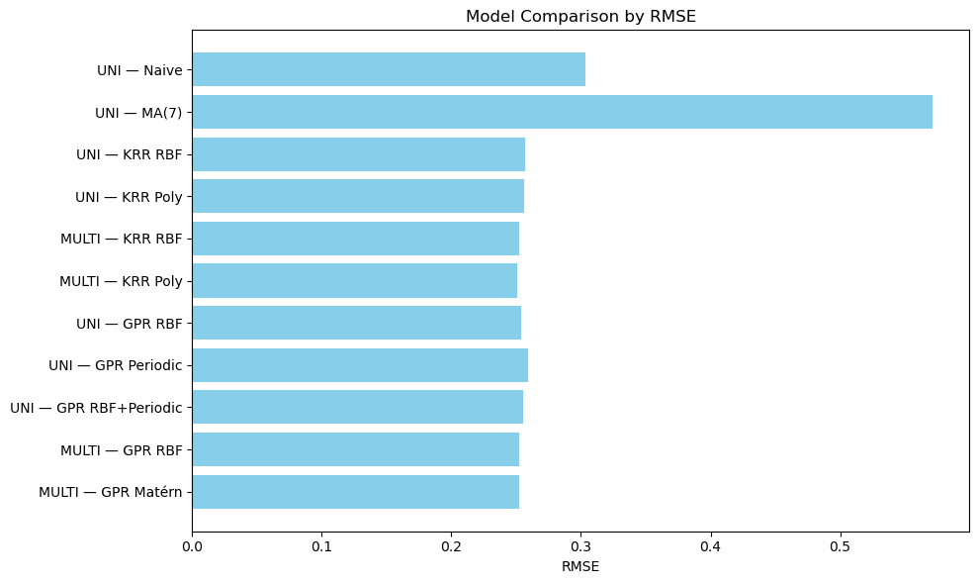
Results & Summary
Top 3 models
Multivariate KRR (Poly) – RMSE: 0.2508
Multivariate KRR (RBF) – RMSE: 0.2521
Multivariate GPR (RBF) – RMSE: 0.2524
EECE 5644
Intro to Machine Learning

Slide 9
EECE 5644
Intro to Machine Learning
Discussion & Insights
Multivariate > Univariate: Additional electrical features improve forecasts.
Kernel Choice: Polynomial kernel performed best for KRR.
GPR Advantage: Provides interpretable uncertainty estimates.
Seasonality: Periodic kernels helped but less than expected in univariate case
.

Slide 10
Conclusion
Future Work
Kernel methods (KRR & GPR) effectively model nonlinear energy consumption.
Multivariate inputs yield significant accuracy gains.
Multi-output GPR
Deep kernel learning
Include exogenous variables (weather, pricing)
Locally periodic kernels for evolving seasonality
EECE 5644
Intro to Machine Learning

Slide 11
Thank You

